Slide 1
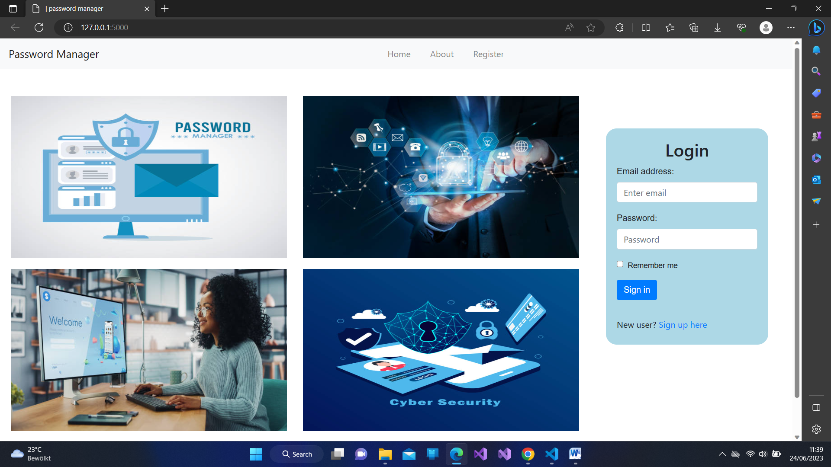
Home page

Slide 2
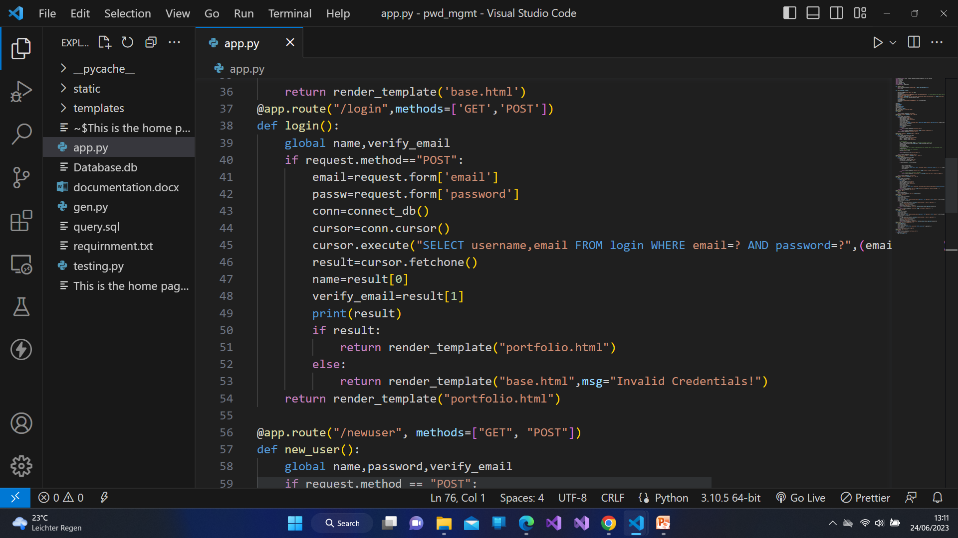
Login code

Slide 3
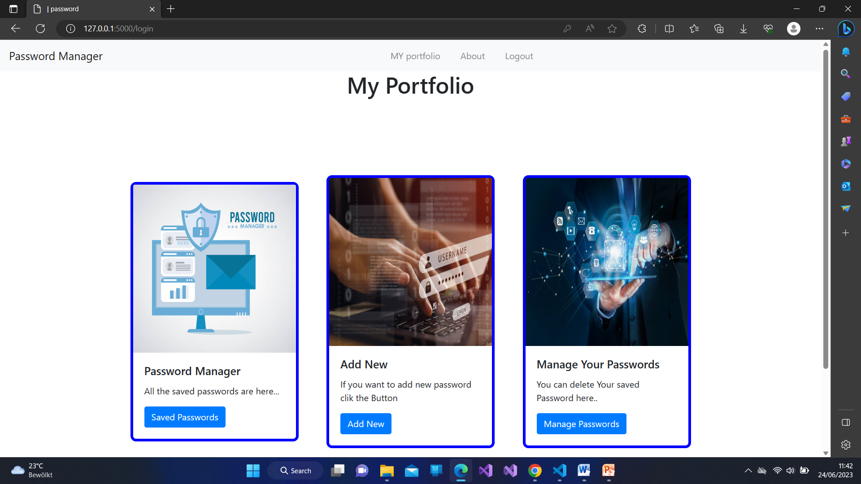
Our Portfolio There are three options 1.Saved passwords : show all the saved passwords . 2.Add New : Here we add new account of a web to our password manager. 3.Manage passwords: here we delete our saved passwords.

Slide 4
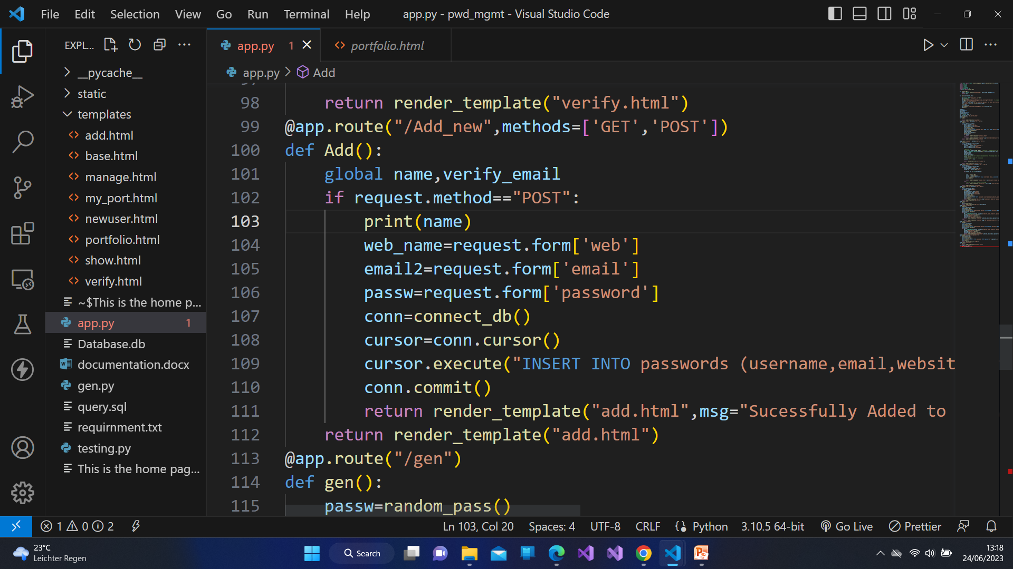
Adding new password code

Slide 5
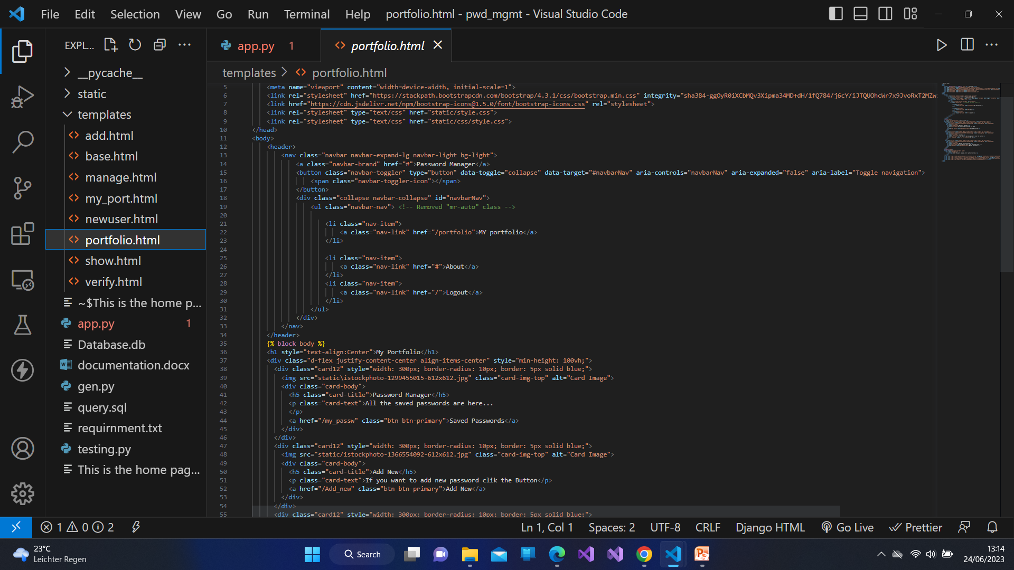
Portfolio code

Slide 6
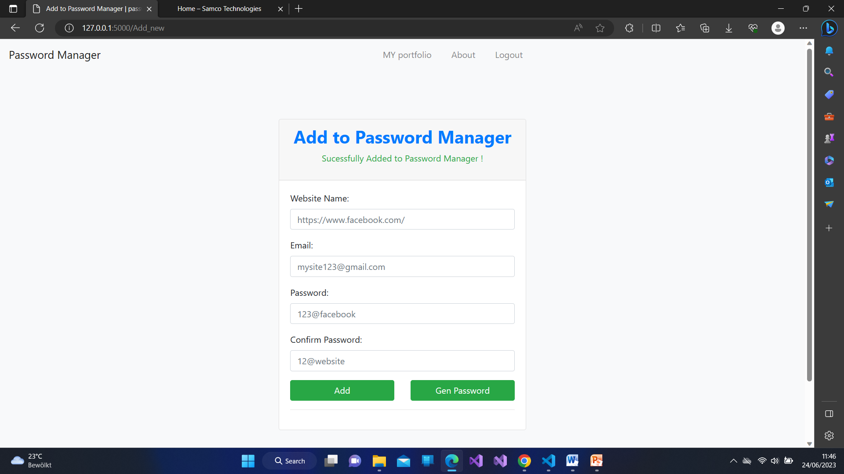
Adding new password Here is a option of generate password which generate a random password..

Slide 7
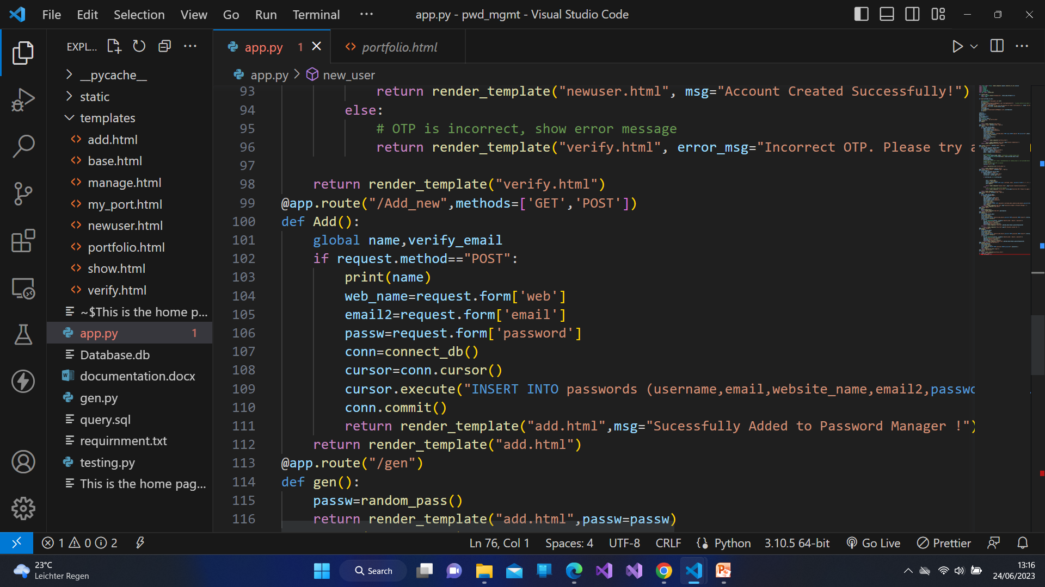
Adding new password to password manager code.

Slide 8
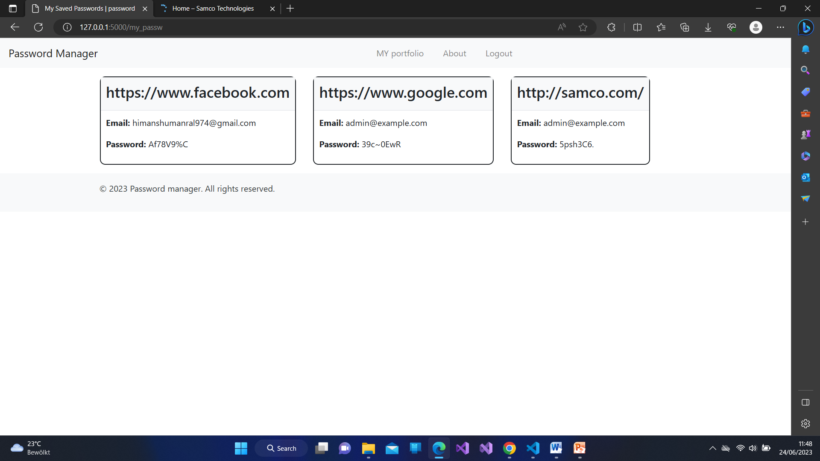
Password manager Here we see our all the saved passwords ..

Slide 9
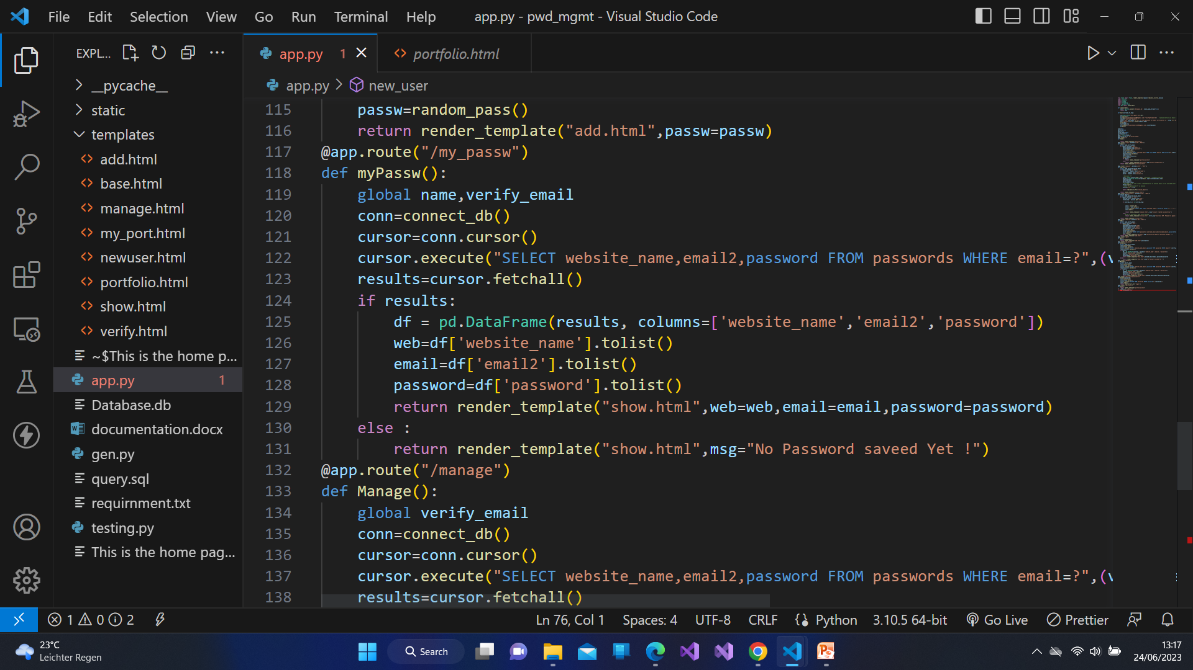
All saved passwords code

Slide 10
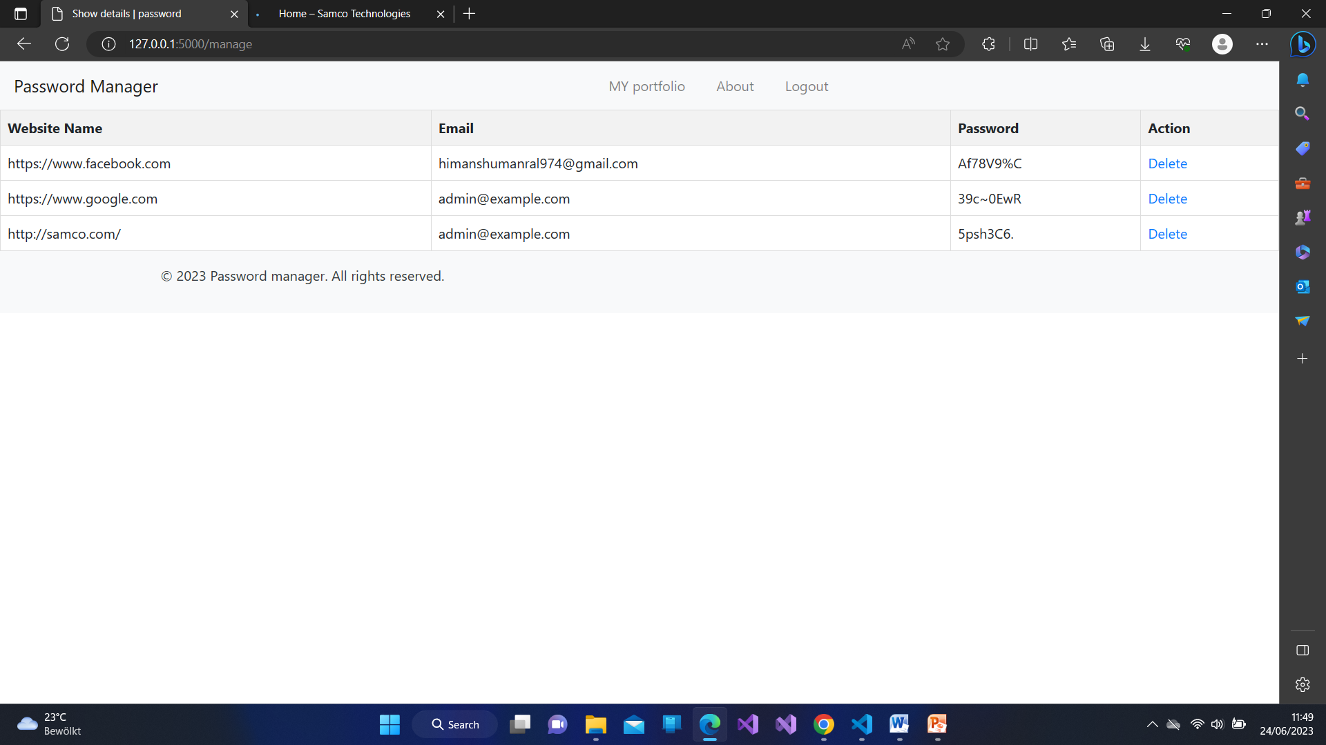
This is the page of manage passwords here we can delete our saved passwords .

Slide 11
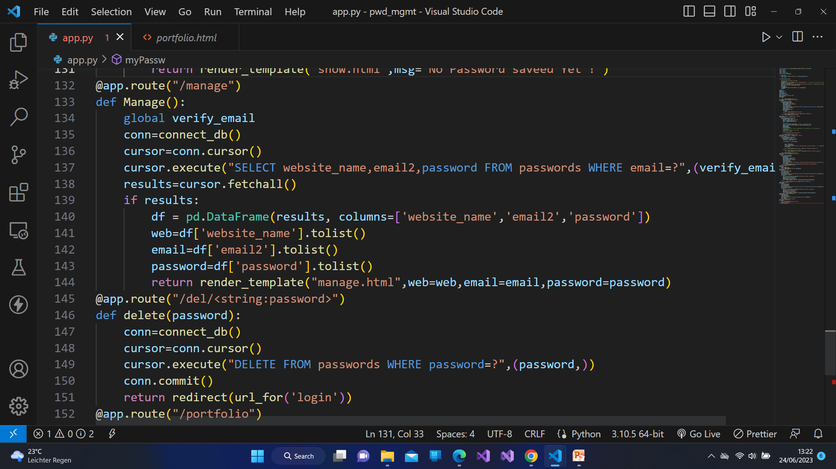
Delete Passwords

Slide 12
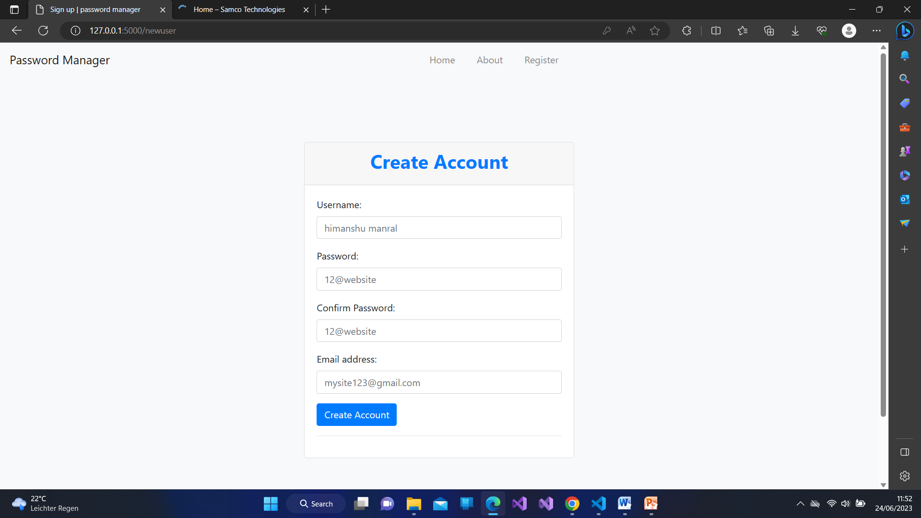
Create new account page From here we can create a new account ..

Slide 13
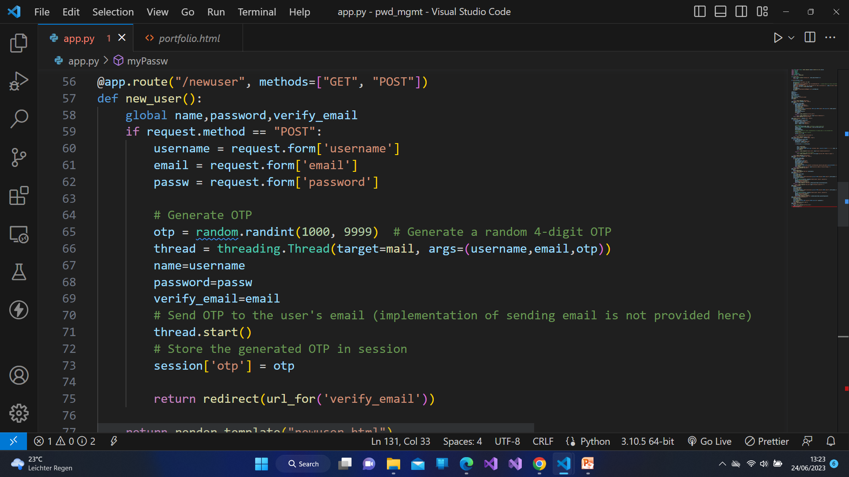
New user code

Slide 14
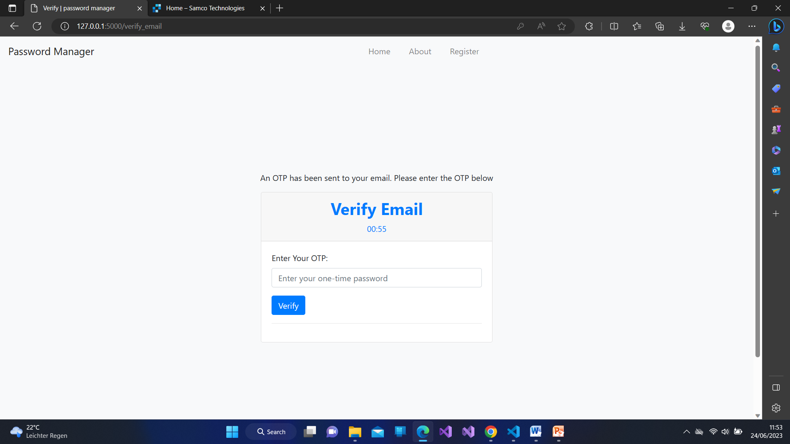
Otp verification page Here a otp is send to the new user’s mail they have to enter the otp here only than the account will create.. Once the OTP verified the account will created successfully..

Slide 15
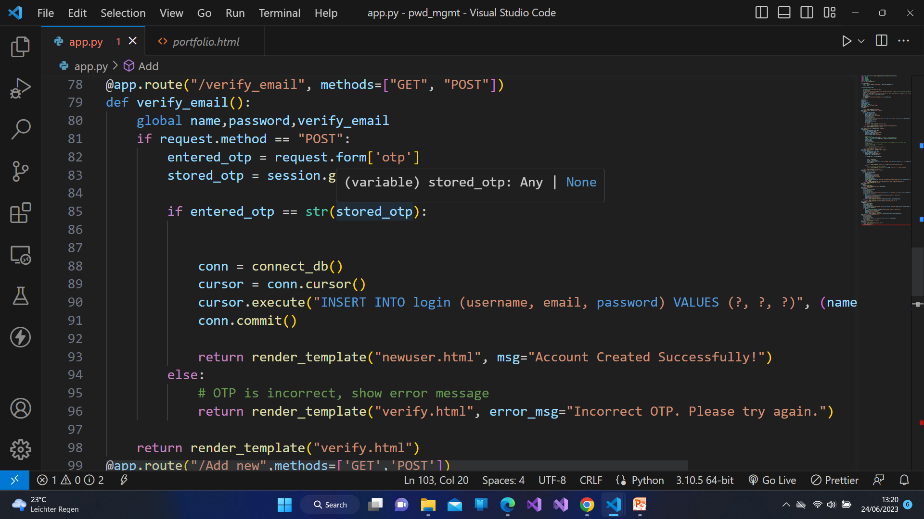
Varification code

